Slide 1
Configuration Management

Slide 2
Goal – Primary Objective
To provide a logical model of the IT infrastructure by identifying,controlling, maintaining and verifying the versions of ALL Configuration Items in existence.

Slide 3
Types of CIs
4 CI Types
Hardware
Software
Documentation
  Processes and Procedures
  Technical documentation
  Diagrams/Charts
4. IT Staff NOT USERS

Slide 4
Why Configuration Management?
Account for ALL IT assets
Provide accurate information to support other Service Management processes
Provide a sound basis for all other Service Management disciplines
Verify records against the infrastructure and to correct exceptions

Slide 5
5 Activities of Configuration Management
Planning
- Strategy, policy, scope, objective, roles & responsibilities
- Config Mgt processes, activities and procedures
- CMDB, Relationships with other processes and 3rd parties
- Tools and resource requirements
Identification
- Selection, identification and labelling of all CIs - Relationships
Control
- Authorised additions, modifications and removal of CIs
Status Accounting
- The reporting of all current and historical data of each CI
Ordered, Under Repair, Live, Test …….
Verification & Auditing
- Reviews and audits to verify physical existence of CIs
Notes:
CIs should be recorded at a level of detail, justified by the business need – typically
to the level of “Independent Change”
All CIs will be under Change Management control
Change management will update Configuration Database
See Diagram pg 25

Slide 6
Key Considerations
Configuration Items (CIs)
Component of an infrastructure that is (or is to be) under the control of Configuration Management
Configuration Management Database (CMDB)
A database that contains all relevant details of each CI and details of the important relationships between CIs
Base Level
The lowest level at which CIs are uniquely identified
Baseline – A SNAPSHOT
The configuration of a product or system established at a specific point in time, capturing both structure and details

Slide 7
Example Software Structure
Software
System
Application
2
Application1
Application
3
Programme
A
Programme
C
Programme
B
Module
1
BASE LEVEL
(CI Level)
The lowest level at which CI’s are
uniquely identified
Subroutine
1
Subroutine
2

Slide 8
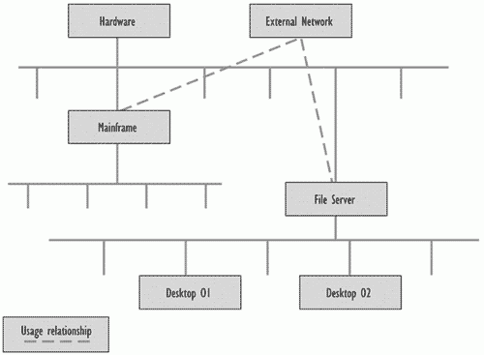
Attributes
Attributes
- Unique Identifier
- CI Type ID
- Name
- Version Number
- Model / type identification
- Place / location
- Supplier
- CI History
- Status
- Relationships
- VARIANTS

Slide 9
Relationships
Relationships
- ..is a parent/child of..
- ..is a version of..
- ..is connected to..
- ..applies to..(e.g. documentation)
- ..is used for.. (CI’s related to service)
- ..is a variant of.. (MS Dictionary English vs. Dutch)
Any others that are meaningful and useful to the organisation can be used

Slide 10
Benefits
Provides accurate information on CIs and their documentation to support all other Service Management disciplines
Facilitates adherence to legal and contractual obligations
Improves security by controlling the versions of CIs in use
Setting up Configuration Management
The planning process for setting up could take up to 6 months. Actual implementation may take much longer, but the benefits of Configuration Management should outweigh the cost

Slide 11
Exam Tips
CFig
•The key to configuration management is that it identifies RELATIONSHIPS between CI’s
•Configuration Activities
    Planning
    Identification of Configuration item (CI)
    Control
    Status Accounting (ordered, delivered,tested, installed, under repair, retired)
    Verification & Audit
•Configuration Management Database
    Hardware
    Software
    Documentation
    IT Staff

Slide 12
Exam Tips Continued
Documentation CI’s
    Processes and Procedures
    Technical Documentation
    Organisational Charts / Diagrams
All CI’s have a number of ATTRIBUTES
    CIS’s ALWAYS have Unique ID and CI Type ID attributes
Base Level lowest level a CI is uniquely identified
Baseline = Snapshot of CMDB structure and detail
CI Variant is an additional CI attribute e.g. Keyboard CI may have French and English variants

Slide 13
Exam Questions
What information does Configuration Mgt provide to the IT management of an organisation?
A Variations from agreed service levels (IM)
B Time spent on investigation and diagnosis by each support group (IM)
C Number of incidents and problems per category (IM)
D Details and history of the IT infrastructure

Slide 14
Exam Questions
A Configuration Management Database (CMDB) can contain different Configuration Items (CIs). Which of the items below would NOT normally be regarded as a CI?
A A user name
B A video monitor (SW)
C A bought-in software package (HW)
D A procedure (DOC)

Slide 15
Exam Questions
What is the main difference between a CMDB (Configuration Management Database) and a typical asset register?
A A CMDB is a computerised system – most asset registers are not
B There is no difference
C Only hardware and software is recorded in a CMDB
D A CMDB is a database that shows the relationships between items

Slide 16
Exam Questions
Which of the following can be regarded as CIs?
Hardware
Documentation
Staff (NOT USERS)
Software
Network components
A 1,4 & 5
B 1,2,4 & 5
C 1 & 4
D All of them

